Slide 1
Session 5 Tools of the Industry
What’s Hot in the Analytics Industry
Oct. 20, 2022

Slide 2
Career Services Updates
By Amy Bartachek

Slide 3
Professional Details, Profile, Documents and Offers
1. Resume: Your resume is a continuous work in progress, take some time to review it.
2. LinkedIn Profile—don’t overlook your online presence and check out these free Tippie banners
3. References—find people who can be favorable references and keep them informed of what you are up to.
October 26 from 12:00-12:45pm. Your Professional Brand & LinkedIn - Online via Zoom: RSVP to attend the Career Services webinar
Have you secured a summer internship? I want to hear about it and celebrate with you! Send me an email or stop in to give me an update: amy-artachek@uiowa.edu

Slide 4
Accepting Offers, Negotiating and Etiquette
Your circumstances, goals and offer-terms will be unique to you. Your Career Coach can better support your decision with information and details.
Negotiate: your salary and acceptance timeline
Rescinding offers: the affect it could have on your professional brand, relationships with companies, and Tippie reputation
Questions or need some guidance? Schedule an Appointment

Slide 5
Tools of the Industry

Slide 6
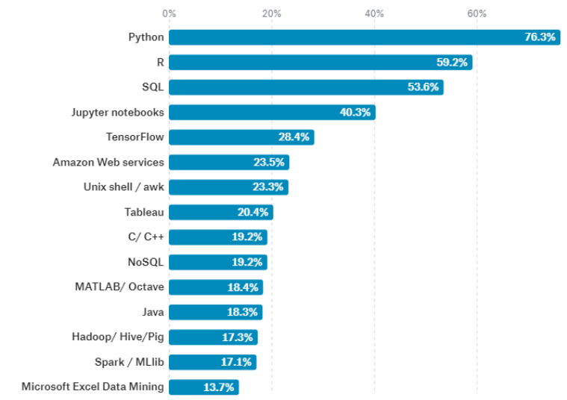
Top 15 Tools
https://blog.revolutionanalytics.com/2017/10/survey-of-kagglers.html

Slide 7
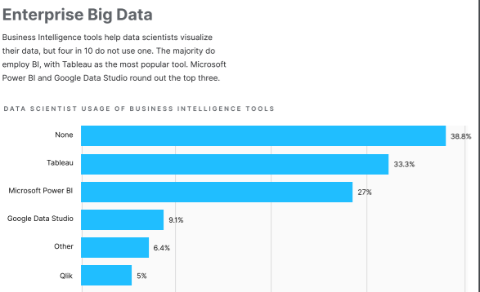
Business Intelligence Tools

Slide 8
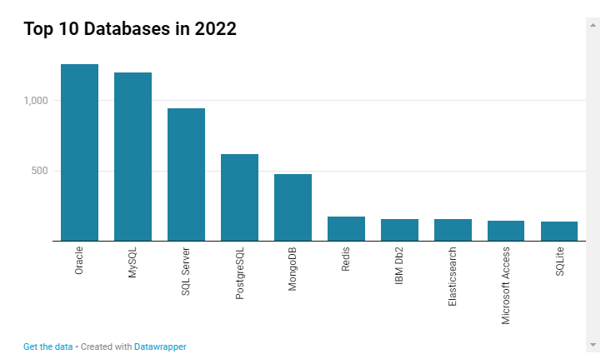
Popular Databases
https://towardsdatascience.com/top-databases-to-use-in-2022-what-is-the-right-database-for-your-use-case-bb8d3f183b21

Slide 9
Popular Tools
Power BI
Alteryx
Trello
GitHub
Spark
Agile

Slide 10
Group Exercise
Power BI
Alteryx
Trello
GitHub
Apache Spark
Agile
Provide a high-level summary of the tool.
How is this tool used in the analytics industry?
Why would you use this tool?
Does this tool interface with other tools or software?
What types of jobs or roles use this tool?

Slide 11

What is GitHub
A really cute cat octopus?
Open-source repository for storing software code
Allows tracking of iterations (version control)
Collaboration tool
AND…A GREAT WAY TO SHOWCASE YOUR SKILLS TO EMPLOYERS

Slide 12
Getting Started
GitHub and Git Basics Video
Learn more through:
LinkedIn Learning – Free to U of Iowa students
lab.github.com
Upload source code and project samples
Add GitHub public link to your resume

Slide 13
GitHub Page Samples
Kris Arens: https://github.com/kristinearens
Canny Li Page: https://mobius21.github.io/markdown-portfolio/
Zach McDaniel: https://zachmcdaniel.github.io/
Chad Nelson’s Page: https://chad-nelson.github.io/

Slide 14
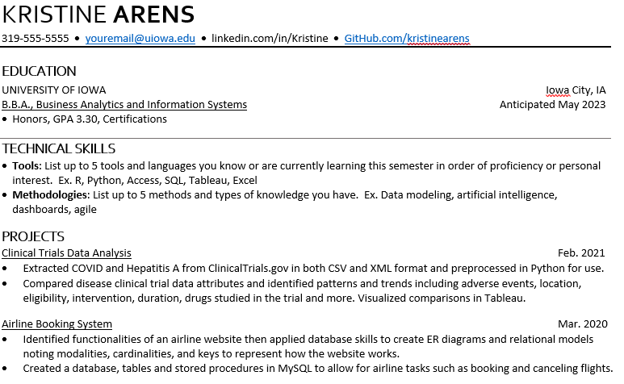
GitHub on Resumes
Showcase your work
Match repository to projects
Provide:
Code examples
Presentations
Data Analysis

Slide 15
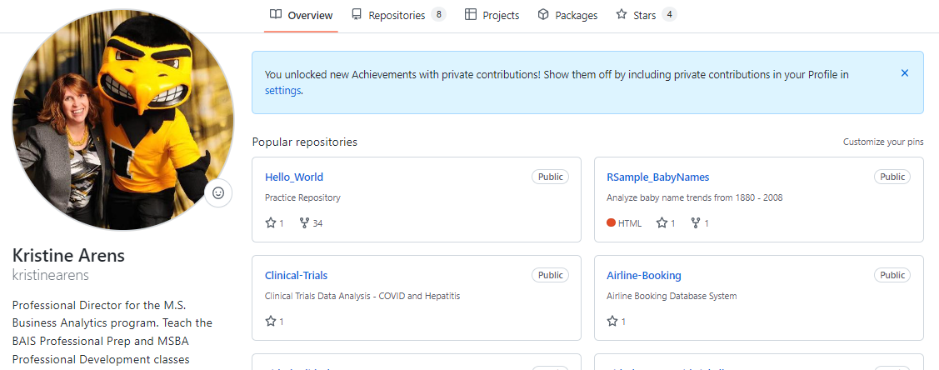
Let’s Take a Look
https://github.com/kristinearens

Slide 16
Next Session

Slide 17
Next Session (Nov. 3) – Industry Trends
Let’s Discuss What’s Happening:
Data Visualization and Graphs
Data as a Service
Personalized Data
Artificial Intelligence
(Maybe a speaker….this class may adjust a bit. I appreciate your flexibility)

Slide 18
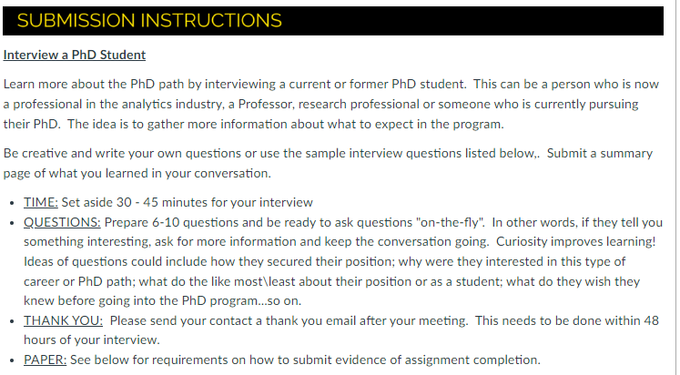
Assignment: Interview PhD Student

Slide 19
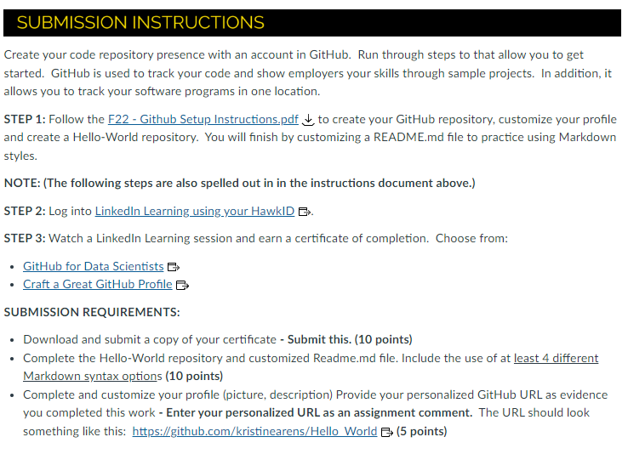
Assignment – GitHub w/LI Learning

